Slide 1
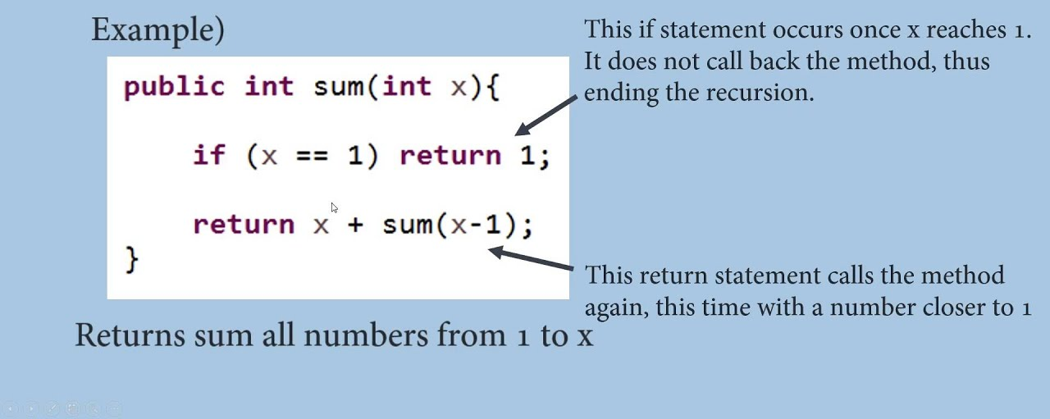
Recursion

Slide 2
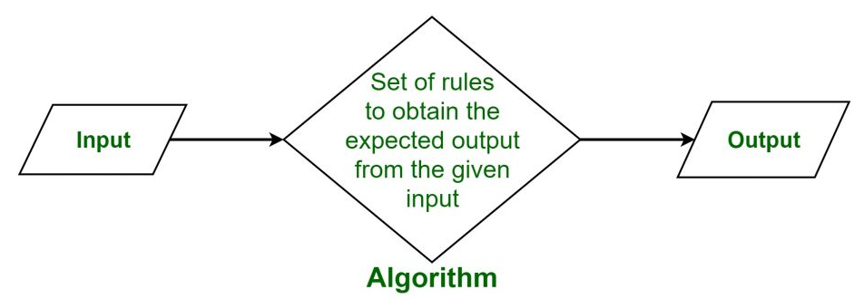
Algorithm

Slide 3
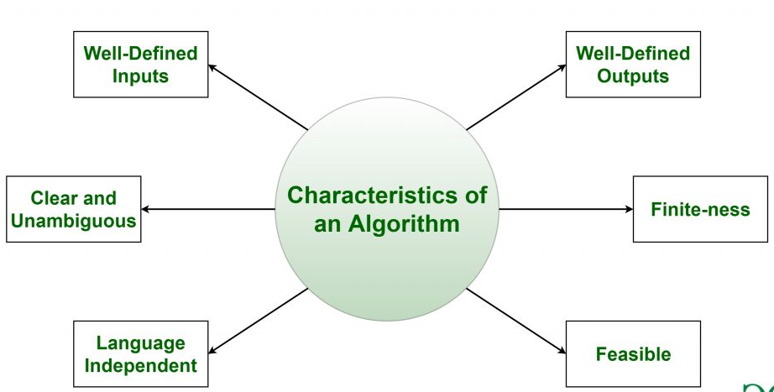
Characteristics of an Algorithm

Slide 4
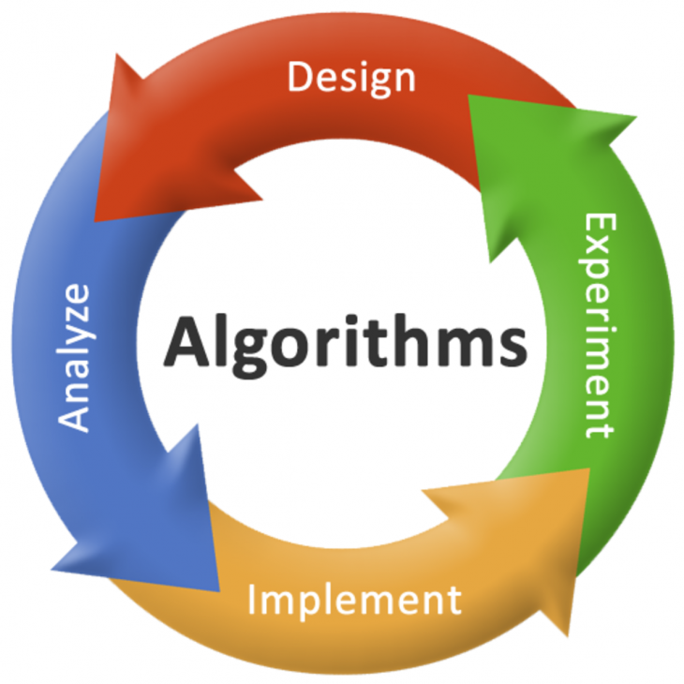
Algorithm

Slide 5
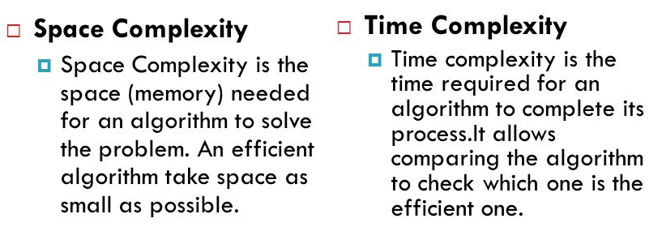
Space & time complexity

Slide 6
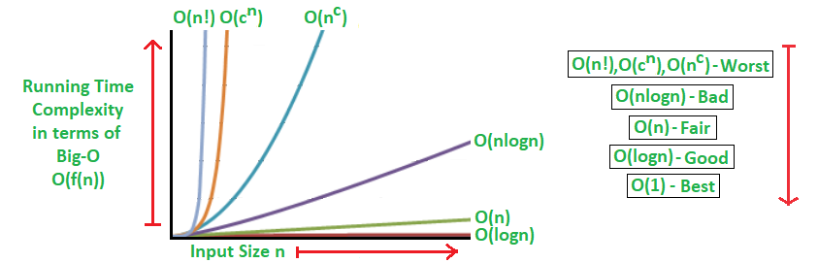
Big-O notations

Slide 7
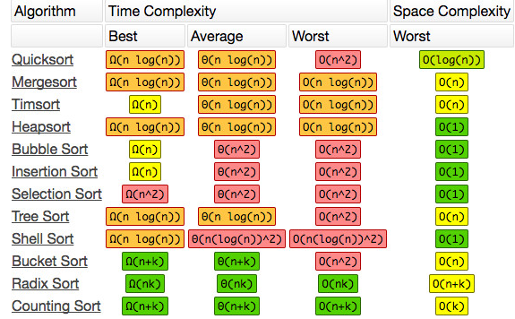
Sorting chart

Slide 8
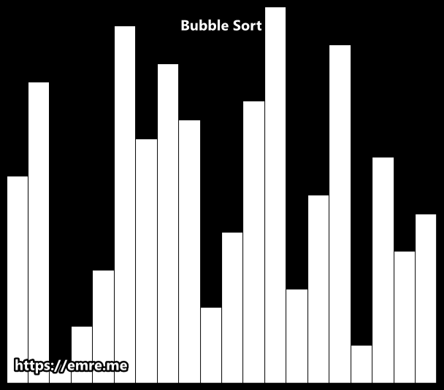
Bubble sort O(n²)

Slide 9
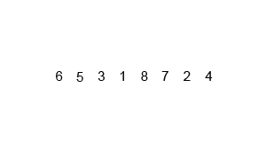
Merge sort O(n*log(n))

Slide 10
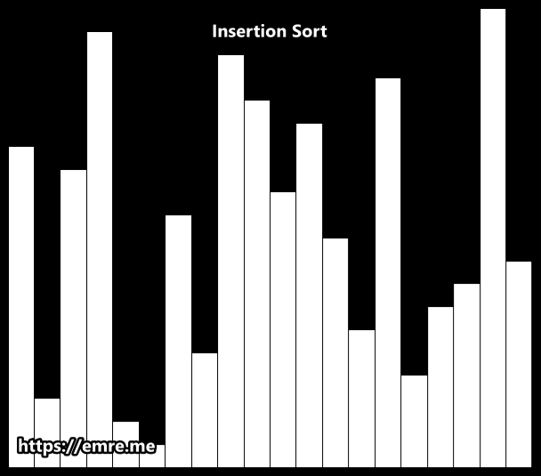
Insertion sort O(n²)

Slide 11
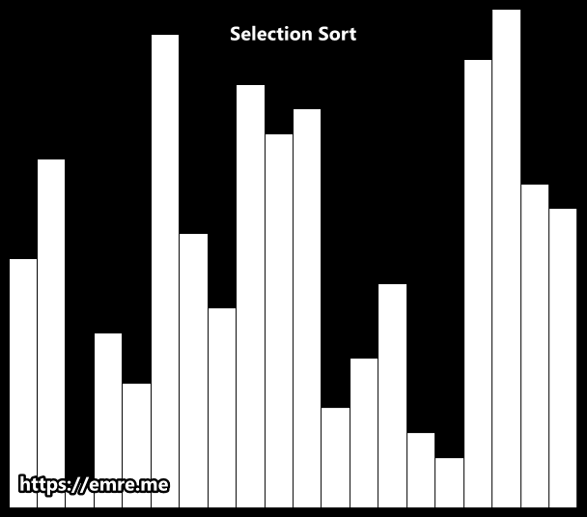
Selection sort O(n²)

Slide 12
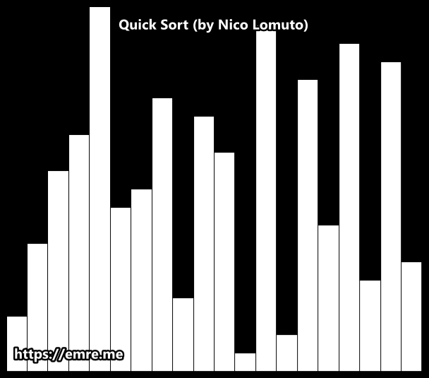
Quick sort O(n²)

Slide 13
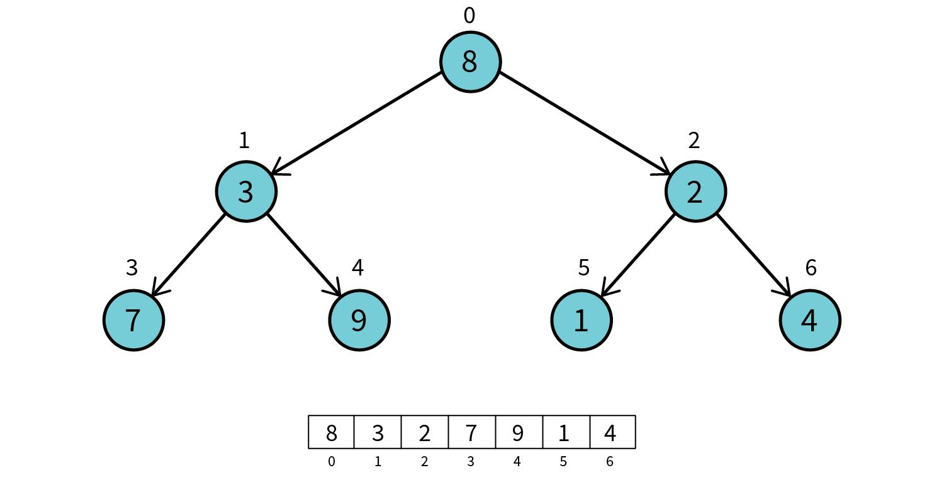
Heap sort O(n*log(n)) 1step

Slide 14
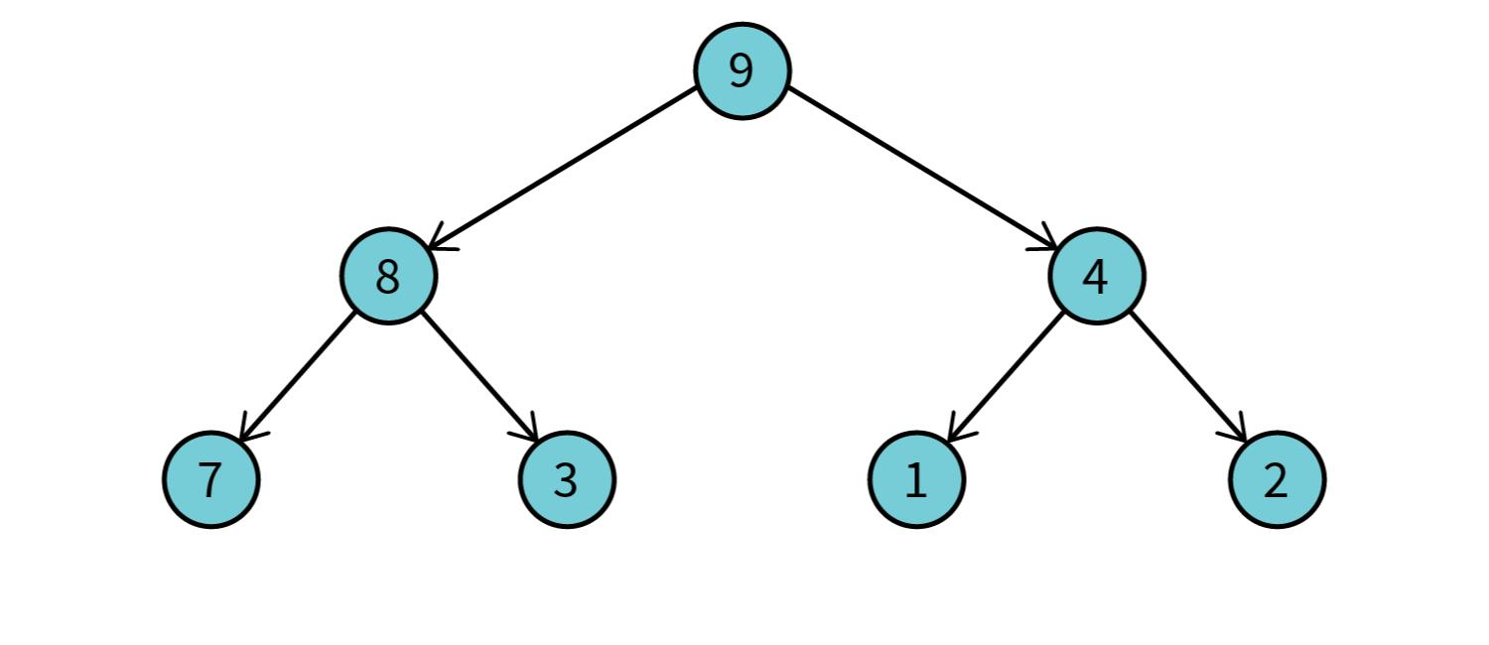
Heap sort O(n*log(n)) 2step

Slide 15
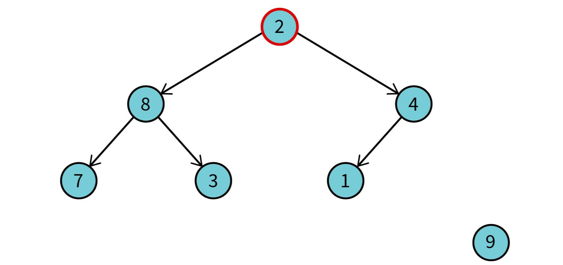
Heap sort O(n*log(n)) 3step

Slide 16
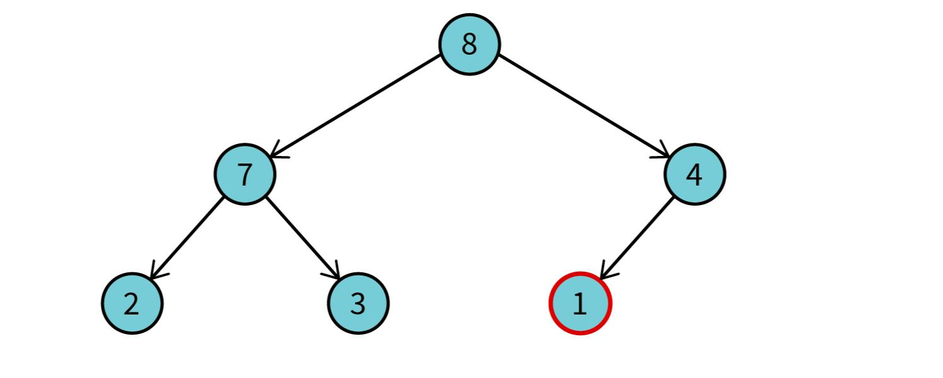
Heap sort O(n*log(n)) 4+steps

